Slide 1
MEMORY MANAGEMENT

Slide 2
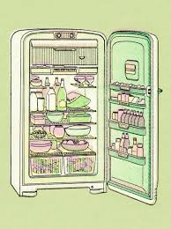
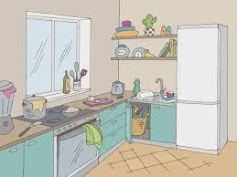

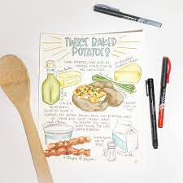

External memory
RAM
Chopping = ALU
Corner = Cache
Register
Control Unit

Slide 3
Storage | Speed | Capacity | Relative Cost | Pernament
Registers | Fastest | Lowest | Highest | No
RAM | Fast | Moderate | High | No
Floppy disk | Very slow | Low | Low | Yes
Hard disk | Moderate | Very high | Very low | Yes

Slide 4
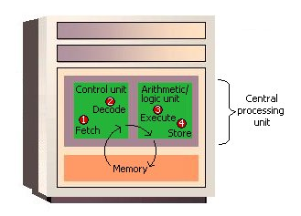
Fetch + Decode = I time
Execute + Store = E time
I time + E time = Machine cycle

Slide 5
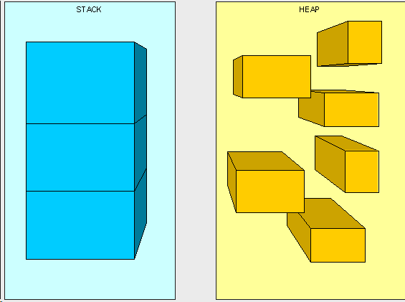
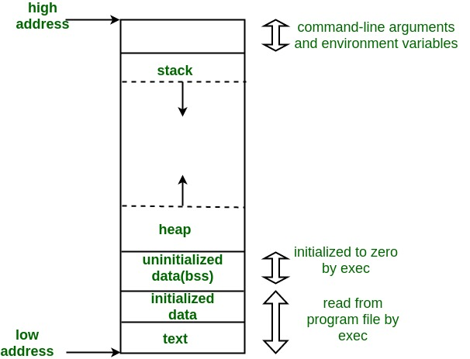

Slide 6
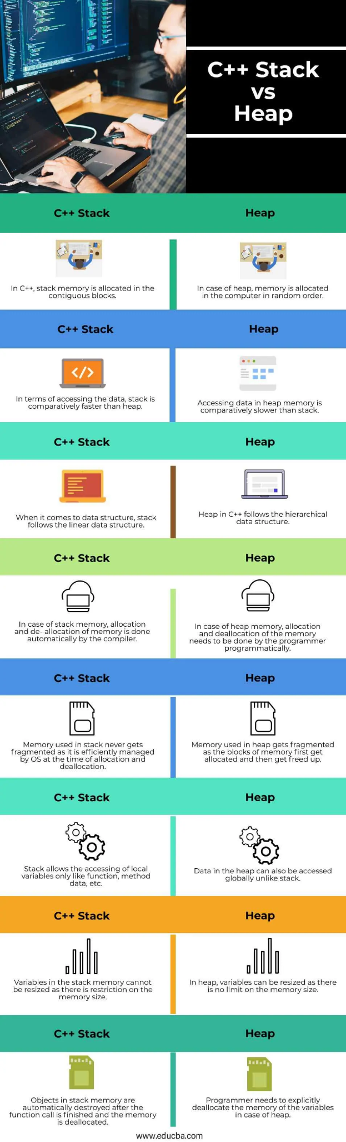

Slide 7
STATIC MEMORY ALLOCATION:
ADVANTAGE | DISADVANTAGE
Fast Access | Limited Flexibility
No overhead | Wastage of money
Persistent data | Limited Scope
DYNAMIC MEMORY ALLOCATION
ADVANTAGE | DISADVANTAGE
Flexible Memory Usage | Slower access
Efficient Memory Usage | Memory leak
Global access | Fragmentation

Slide 8
Stack overflow:
If a program consumes more memory than the stack size, a stack overflow occurs, resulting in a program failure.#include<stdio.h>
void fun(int a) {
if (a== 0)
return;
a += 1;
printf("\n");
printf("%d",a);
fun(a);
}

Slide 9
Heap Overflow:
#include<stdio.h>
#include<stdlib.h>
int main()
{
for (int i=0; i<1000000000000000000; i++)
{
int *z = (int *)malloc(sizeof(int));
}
}
#include<stdio.h>
#include<stdlib.h>
int main()
{
int *ptr = (int*)malloc(sizeof(int)*10000000);
}

